Slide 1
Can we predict music’s popularity?
Springboard – Data Science Career Track
Marcelo Fuentes
January 2020

Slide 2
Problem & Context
The aim of this project was to determine whether it is possible to predict with high precision the popularity of a song based purely on the song's demographics.
The features used to answer this question included music loudness, acousticness, year released, danceability, duration, etc. This data came directly from Spotify’s database and it was shared on an online repository on Kaggle.com

Slide 3
Success Metrics & Constrains
It was determined that finding a model with over 80% of predictive power would be deemed to be a success. Four (4) different models were used in testing Random Forest, k-Nearest Neighbors, Logistic Regression and Linear Regression.
A constrain in this dataset was the large variety of artists and artist collaborations in the dataset which rendered this descriptive variable useless inhibiting the use of binary encoding

Slide 4
Preliminary Data Analysis
This dataset included 13 variables numerical variables, which implied a lot of flexibility for model selection and feature engineering
The dataset also had an intuitive “dependent” variable, since music popularity is a factor whose value is of great interest to professionals in the music industry as well as consumers in the market
Given that music has a lot of embedded features that an inherent to sound, this dataset also had very few (if any) data gaps and/or missing features for every single record

Slide 5
Feature Engineering
To normalize our data we performed some feature engineering using pandas’ qcut which cuts a variable into user specified quantiles
The data was split into (5) quintiles and assigned a number from 1-5 in terms of popularity. This variable was used to run 3 of the 4 models proposed
For the last model (Logistic Regression) we took the top 2 quintiles and binary encoded them to symbolize 1= popular music and 0 = less popular/unpopular music.

Slide 6
Exploratory Data Analysis
Some of salient features we uncovered during our EDA included:
The correlations between popularity and the variables year, acousticness, energy and loudness
The abnormal positive distribution in terms of music popularity
The initial trends between energy, year and popularity

Slide 7
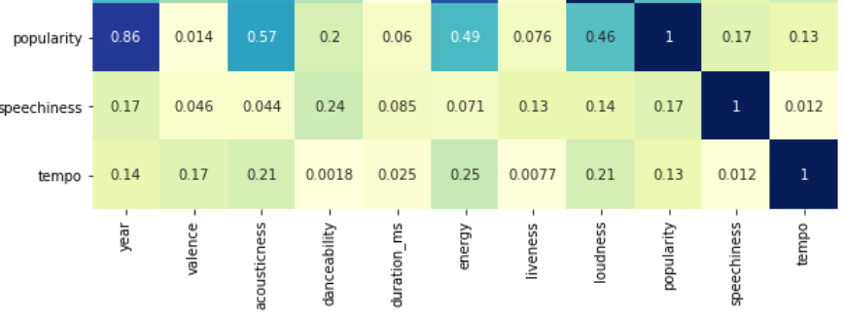
Exploratory Data Analysis
Variable correlations

Slide 8
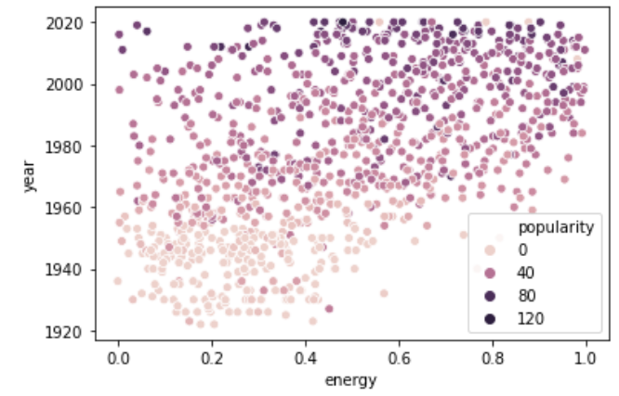
Exploratory Data Analysis
Scatter – year, energy and popularity

Slide 9
Exploratory Data Analysis
Scatter – year, energy and popularity

Slide 10
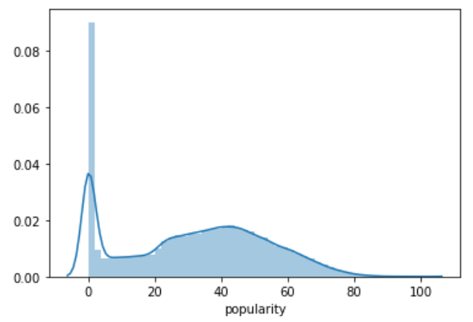
Exploratory Data Analysis
Histogram of song popularity figures (0 = min, 100= max)

Slide 11
Modeling
The machine learning methods chose were the following:
1) Random Forest: for its efficiency
2) k-NN: as a an alternative to RF for clustering
3) Linear Regression: due to continuous nature of data
4) Logistic Regression: due to categorical nature of new ‘popularity’ feature

Slide 12
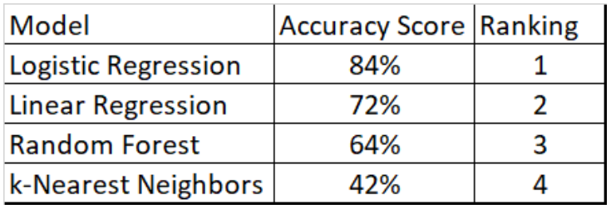
Analysis Results
The results from the modeling were the following:
The best performing model was that logistic regression and the linear regression cameinsecond

Slide 13
Recommendation
My recommendation would be to use the logistic regression model to determine whether a song is popular or not
However, if there is a business need for an ordinal popularity value the best model to be use would be the linear regression model

Slide 14
Future Studies
An interesting analysis would be to group songs based on musical genre to test whether these trends/patterns hold within each individual music genre.
Removing the year variable to perform this analysis using song’s intrinsic/fundamental demographics could very valuable as well

